Slide 1
Developmental Expectations
Summer Jones, M.A. Ed.

Slide 2
Today’s Discussion
What to expect in your parent-teacher conference
Understanding the progress report (and child development)
Types of questions to ask teacher
What happens if teacher shares a concern?
What if parent has a concern about development?
Understanding kindergarten readiness/school readiness (*Surprise, it begins at birth)

Slide 3
Parent-Teacher Conference
Conversation
Questions
Concerns
Notes:
Think of it as a well-visit with pediatrician. A lot of sharing, may feel like a lot of talking from teacher but you can ask questions, share information about your child, what works at home, where you feel unprepared. You may want to have prepared any questions you have

Slide 4
Guiding Principles
Every child develops at his/her own pace and has diverse learning needs and approaches.
Tuning in and being aware of the child’s specific needs and where they are developmentally can help you adjust the environment, daily activities and your expectations.
Appropriate and realistic expectations for a child’s behavior based on their development
Generally, we are more familiar with and talk about physical development and milestones but not as much about social-emotional milestones
Notes:
While difficult, not good to compare your child to others. Those of you with multiple children have probably seen this first-hand, no two children are alike.

Slide 5
Expectation Gap
(ZERO TO THREE, 2016)
Notes:
While difficult, not good to compare your child to others. Those of you with multiple children have probably seen this first-hand, no two children are alike.

Slide 6
Expectation Gap
(ZERO TO THREE, 2016)
Notes:
While difficult, not good to compare your child to others. Those of you with multiple children have probably seen this first-hand, no two children are alike.

Slide 7
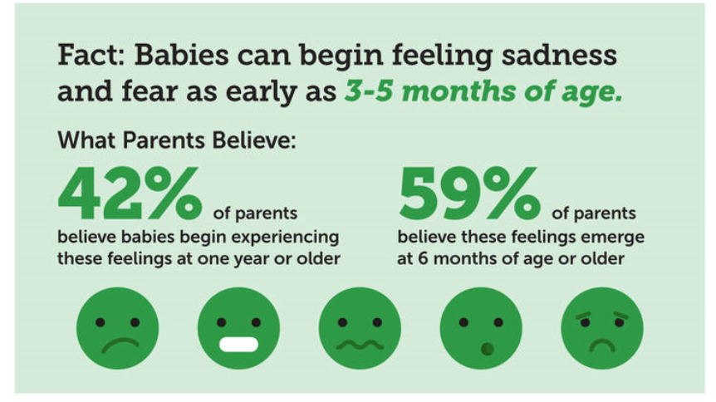
Expectation Gap
(ZERO TO THREE, 2016)

Slide 8
Progress Reports
Explanation of Progress:
1 - Does very well
2 - Satisfactory progress for age
3 - Needs more time to develop and progress
N/A - Not applicable at this time
Notes:
If all 2’s, that’s great!
If some 3’s, that’s totally normal because everything on the progress report is “end of the year goals”, and these are January reports, so your child isn’t expected to be meeting these milestones or have them mastered by now, a 3 means child needs more time to work on this.
If some 1’s, that shows child has a solid mastery of that milestone or skills at this time. If a child is at a 1, get creative and have fun to find new ways of do these tasks to continue enriching their experiences. (For example:

Slide 9
Progress Reports
Explanation of Progress:
1 - Does very well
2 - Satisfactory progress for age
3 - Needs more time to develop and progress
N/A - Not applicable at this time
Exactly where your child is expected to be right now.
This means your child is learning, growing, developing as expected based on his/her age.
Notes:
If all 2’s, that’s great! Many will see mostly 2’s here on the January report.

Slide 10
Progress Reports
Explanation of Progress:
1 - Does very well
2 - Satisfactory progress for age
3 - Needs more time to develop and progress
N/A - Not applicable at this time
Completely normal to get 3s on this mid-year (January) report.
Milestones on the progress report are “end of the year goals”, so your child isn’t expected to be meeting these milestones or have them mastered by now.
A 3 means child simply needs more time to work on this.
Notes:
Something to work on at home with them and continue supporting.
If some 1’s, that shows child has a solid mastery of that milestone or skills at this time. If a child is at a 1, get creative and have fun to find new ways of do these tasks to continue enriching their experiences. (For example:

Slide 11
Progress Reports
Explanation of Progress:
1 - Does very well
2 - Satisfactory progress for age
3 - Needs more time to develop and progress
N/A - Not applicable at this time
Show’s child completes this task/milestone at the time
Get creative, continue enriching child’s experiences in this area in new ways
Notes:
For example:

Slide 12
Preparing for Conference
Take time to reflect on your child and his/her experience, strengths
Ask your child what she likes and doesn’t like about school
What questions do you have for teacher?
Notes:
Before going to your conference give yourself some time to think and reflect on your child.
What do you see as your child’s strengths? What does your child like about school? Is there anything he/she has shared that she doesn’t like?
Ask your children these questions.

Slide 13
Questions for Teachers/Caregivers
“What does my child most enjoy doing during the day?”
“How does my child interact with other children?”
“How does my child interact with you and other teachers/ caregivers?”
“What’s does my child bring to the group/class?”
“How can I support this (specific behavior/ milestone) outside of school?
Ask for specifics/examples (of your child’s strengths and challenges)
Notes:
If teacher shares something your child is struggling with, ask for an example.
Also share examples from home/outside of school because our children can show different strengths, challenges with different people, environments.

Slide 14
In the Event of a Concern…
If behavior is outside of expected/typical range, the teacher/caregiver can give referral for an assessment from Early Intervention (EI).
Early Intervention are services and supports available to infants and young children with developmental delays and disabilities and their families.
EI services are available in every state. Speak to your pediatrician or contact your county for more information (see Resources handout for county links)

Slide 15
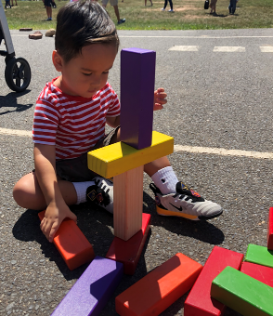
Early Intervention Services
Speech and language services
Physical Therapy
Hearing or audiology services
Occupational Therapy
Counseling and training for a family
Psychological services
Nursing services
Nutritional services
Medical services

Slide 16
In the Event of a Concern…
You are not alone. You’ve done nothing wrong.
Approximately 1 in 6 children have one or more developmental disabilities
Services combine both support for children and support for their families provide the most significant impact.
Teacher is not diagnosing your child, simply expressing concern and recommending an assessment.
Notes:
Share example of my son’s speech assessment.
Mentioned to my pediatrician. Called county, scheduled assessment, they came to our home.
So many things impact young child’s development and sometimes they focus on one area of development and pause on others. Assessment is simply to ensure everything is developing as expected, and if not, to catch it early and start supporting child and family.
3 Reaction States
Primary: Shock, Denial, Depression
Secondary: Guilt, Indecision, Anger, Shame
Tertiary: Bargaining, Acceptance and Adaptation
(As compiled by Sen & Yertserver, 2007)
Ambiguous Loss
Chronic Sorrow

Slide 17
When a Parent’s Concerned…
Refer to developmental milestones lists/info
Collect data – observe your child over time, at different times of the day, in different settings. Gather as much info as possible to understand your child and his/her development
Share information with child’s teacher/caregiver and pediatrician
*REMEMBER, children develop in the context of their relationships and experiences.
Notes:
So if something has changed recently, major transition, then you can expect your child to respond in some way.
New home, new school, new teacher/caregiver, new family member come or gone, death of pet or family member, new baby, Parent changed jobs

Slide 18
(ZERO TO THREE, 2013)
Notes:
School readiness begins at birth. Not because we need to begin teaching our children how to read or showing them flashcards or downloading the newest learning app, but because early learning and the foundation of kindergarten readiness is built in their first relationships and experiences. These skills include: Language and Literacy, Thinking Skills, Self-Control, and Self Confidence.
I call these human skills or life skills.
Ask any kindergarten teacher, elementary, high school teacher, any employer, they’d rather have a child, student, person who can do these things – when you can do these things then child can sit in class and focus on a task without getting frustrated or giving up, can interact with peers and teachers in a cooperative and respectful manner, can problem solve and work independently, can express their needs effectively.

Slide 19
Kindergarten Readiness [Birth – 12 months]
Language and Literacy | Thinking Skills | Self-Control | Self Confidence
Routines – feeding, diapering, bathtime
*Baby connects and bonds with loved ones, figures out how world works
Reading, playing together – communicating with her through sounds, facial expressions, gestures
[Image retrieved from https://www.wpwinstitute.com/
Notes:
Probably not the words that first come to mind when you think about kindergarten readiness and academic success.
Babies come into the world filled with curiosity about the people, objects, and places they encounter. Daily routines like feeding, diaper-changing, and bathtime offer babies especially rich opportunities to have fun, connect and bond with loved ones, and figure out how the world works.
Important early learning skills get their start through these everyday moments between babies and adults. Reading together, and watching your baby to learn how she communicates through sounds, facial expressions, and gestures, are both ways to give her a foundation in literacy and language skills. Self-confidence grows as babies feel loved and nurtured by the adults who care for them. They begin developing self-control (though they won’t master this skill for a quite a while) when you soothe them after an upset. And babies learn to think, and to puzzle out an interesting problem, by using their senses to play and explore the world around them.
Remember: If your baby is interested and involved in an activity—and having fun—he is learning! It isn’t necessary to “teach” very young children. Formal classes and other activities that push babies and toddlers to learn concepts before they are ready do not help their development or make them do better in school. In fact, they can even make children feel like failures when they are pushed to do something they can’t succeed at or don’t enjoy. So treasure these early days of playing and cuddling with your little one—it is exactly what she needs to grow and learn.

Slide 20
Kindergarten Readiness
Language and Literacy | Thinking Skills | Self-Control | Self Confidence
Early language and literacy skills are learned best through everyday moments with your child—reading books, talking, laughing and playing together.
Talk to them and they communicate back to you
Hearing stories read and songs sung aloud.
Give them the chance to play with and explore books and other written materials like magazines, newspapers, take-out menus, markers, and crayons.
Notes:
Young toddlers are little scientists. They are eager to figure out how everything works. This makes the second year an exciting one, as children really begin to venture out into the world to explore, discover, and learn.
One of the things that make this year so much fun is that toddlers are becoming more and more effective at communicating. (In fact, “No!” becomes a favorite word and a powerful way to assert their independence.) By the end of their second year, they will even be making simple sentences, like “more milk” or “want that”. Toddlers have minds of their own, and strong feelings and preferences that they express with gusto. This is the time when your child might develop a favorite story they want to hear over and over, or a favorite game or toy they want to play nonstop.
Remember: If your child is interested and involved in an activity—and having fun—he is learning!

Slide 21
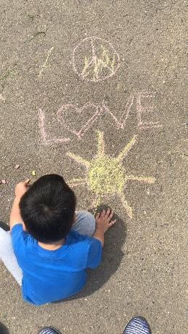
Child development, in all domains, is a specific sequence. Foundations are set and built on before additional skills can be developed.
All of the things your teachers are focusing on during the first years of life as very purposeful, they’re preparing for the next stage, the next development.
This is kindergarten readiness.
Generally, we know what to expect as physical development unfolds, but not in other domains.
Notes:
All of the things your teachers are focusing on during the first years of life as very purposeful, they’re preparing for the next stage, the next development. This is kindergarten readiness.

Slide 22
Child development, in all domains, is a specific sequence. Foundations are set and built on before additional skills can be developed.
Each skill needs to be mastered before the next one can be accomplished.
Physical/ Motor | Social-Emotional | Language | Cognitive
Baby lifts head
Holds head up
Rolls over
Sits up
Crawls
Pulls up to stand
Walks
Runs
Notes:
Each step needs to be mastered before the next one can be accomplished. And all domains of development are like this.

Slide 23
Child development, in all domains, is a specific sequence. Foundations are set and built on before additional skills can be developed.
Physical/ Motor | Social-Emotional | Language | Cognitive
Baby lifts head | Expresses range of emotions | Responds to name | Explores with hands and mouth
Holds head up | Enjoys play with others | Uses some gestures | Responds to familiar sounds
Rolls over | Tries to comfort others | Forms 2-4 word sentences | Match pictures to items
Sits up | Shows respect for others | Understands simple directions | Completes 1-5 piece puzzle
Crawls | Initiates interaction with others | Recounts events sequentially | Counts to 10, then 20, then 30
Pulls up to stand | Adapts to transitions | Follows two-step directions | Recognizes first name in print
Walks | Uses problem solving skills | Expresses ideas | Completes tasks/activities
Runs | Demonstrates empathy | Uses complete sentences | Recalls info previously taught
Notes:
What this means. S/E, a child won’t follow directions/instructions before they can understand “no” or respond to their own name.
Language: not going to speak sentences before they say a single word.
Think about how old you were when you learned to read. And how old our parents were when they learned.
That’s the same age that our children should be learning to read. Just because society expectations and goals for our children have changed, our physiological development, our brain development hasn’t changed, children shouldn’t be expected to learn to read before the age of 5 or 6. That’s just child development.
They build all of the foundations for literacy over their first five years. And then that all comes together when their brains are ready for it.

Slide 24
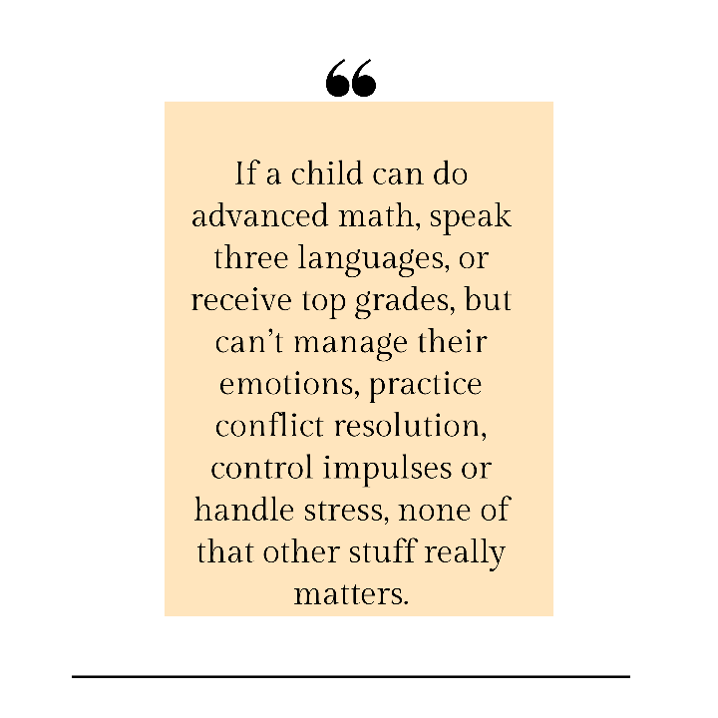
Notes:
Be patient. Focus on human skills, life skills. The person you want your child to become – they don’t magically learn those skills, they need to be broken down and taught, nurtured and coached over time.

Slide 25
Summer Jones
Summer@bewellparenting.com
www.bewellparenting.com

